Slide 1
Operating Budget
Training
Revenues, Expenses, and Transfers

Slide 2
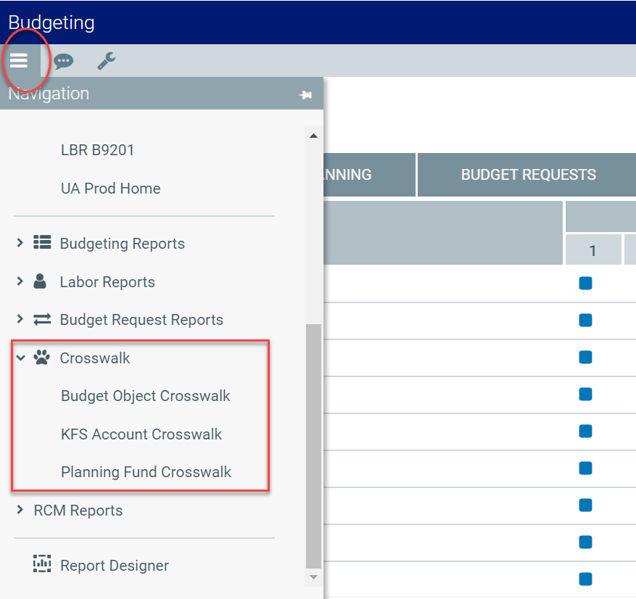
Note: Budget Object, KFS Account, and Planning Fund crosswalk reports are available in Axiom.
Notes:
Crosswalk reports now available in Test Environment.

Slide 3
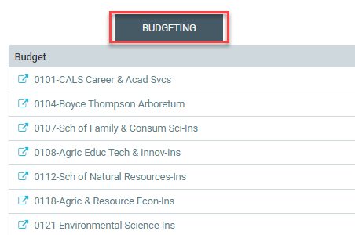
Logging In
Log in using your NetID
Main Screen will display Budgeting Plan File Status
Note: In the Budget and Planning tool, a “Plan File” is the file associated with a specific org or college

Slide 4

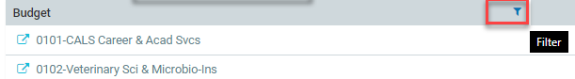
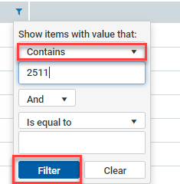
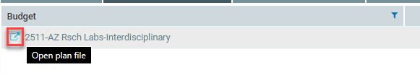
Use the Filter Function to Select your Plan File
Note: In the Production system you will only see Organization codes you have been provisioned to have access to

Slide 5
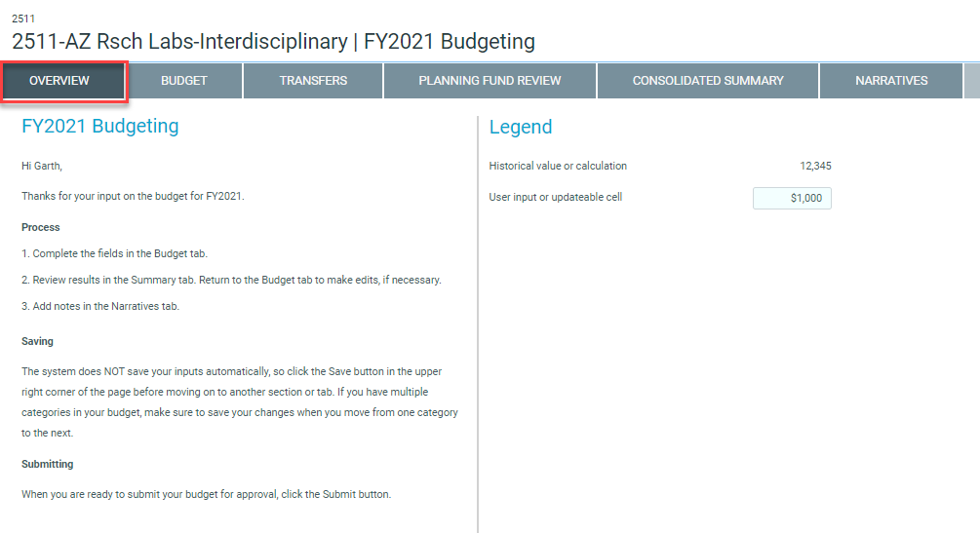
Review “Overview” tab
Read through the overview tab for information about how and why you will plan for Revenue, Expenses, and Transfers:
Make note of the Resources section for additional documentation and information that can assist you
Be aware of the Legend, icons, and formatting pertinent to the Budgeting module
Also of note is that your Plan File has opened in a new browser tab

Slide 6

Revenue & Expense Planning

Slide 7
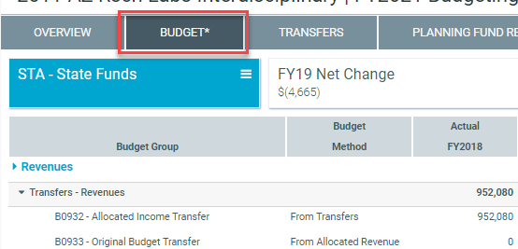
Budget
Overview
The Budget tab is designed to allow you to plan for a variety of changes to your revenues and expenditures:
Financial Data Loaded to Assist You
Scrolling
Select Your Planning Fund
Mark a Planning Fund Reviewed
Change Plan View, Planning Months, Out Years, and Budget Request Views

Slide 8
Budget
Overview
The Budget tab is designed to allow you to plan for a variety of changes to your revenues and expenditures:
Forecast FY20 Revenues and Expenditures
Propose a Budget for FY21 for Revenues and Expenditures
Propose Monthly Budgets for FY21
Create a Plan for FY22 and FY23 Revenues and Expenditures
Add or Change New Planning Funds for your Organization
Add New Budget Groups
Add New Budget Objects

Slide 9

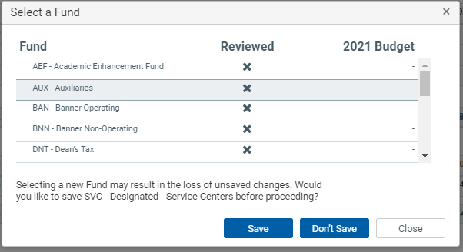
Select Your Planning Fund
You select the Planning Fund to enter data in by using the menu (aka “hamburger”) icon in the blue navigation panel and then highlighting the fund in grey that you want to plan. You need to indicate if you want to save the data in the Planning Fund you are in before navigating away.

Slide 10
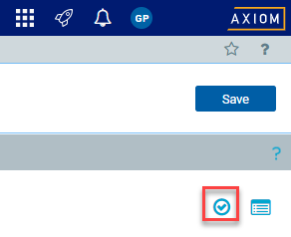
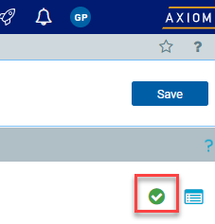
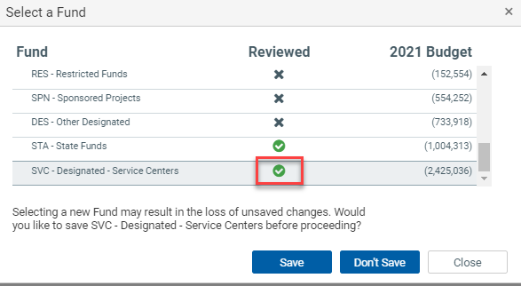
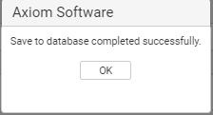
Mark Planning Fund Reviewed
Marking a Fund as “Reviewed” allows you to track your progress/work if you are planning multiple Funds. Once they are all marked “Reviewed” you know you may be ready to Submit.

Slide 11
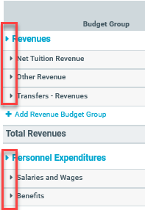
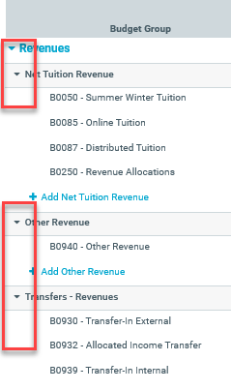
Expand/Collapse Content
Click on arrows appearing on the left side of each Budget Group Category and Budget Object groups to expand and collapse content.

Slide 12
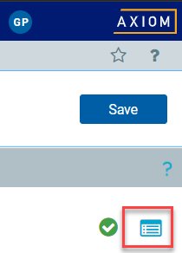
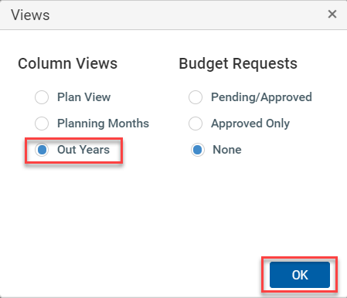

Changing Your View - Out Years
Changing your view to display “Out Years” means you are changing the display to show Planning Years FY22 and FY23..

Slide 13
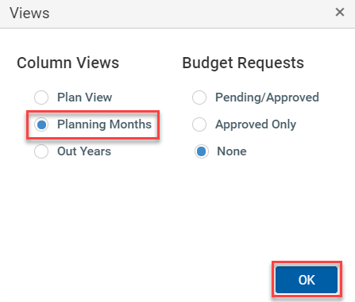
Changing Your View - Planning Months
Changing your view to display “Planning Months” means you are changing the display to show the Months within Budget Year FY21.

Slide 14
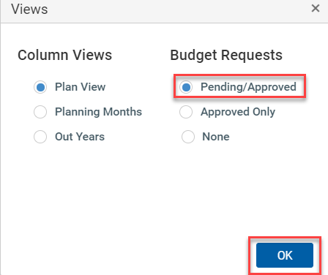
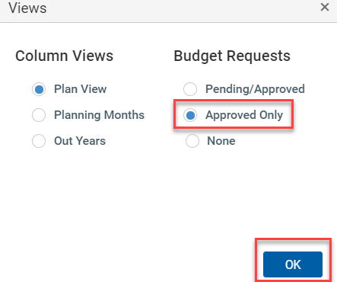

Changing Your View - Budget Requests
Changing your view to display “Pending/Approved” or “Approved Only” Budget Requests means you are changing the display to show data produced in the Budget Request Module.

Slide 15
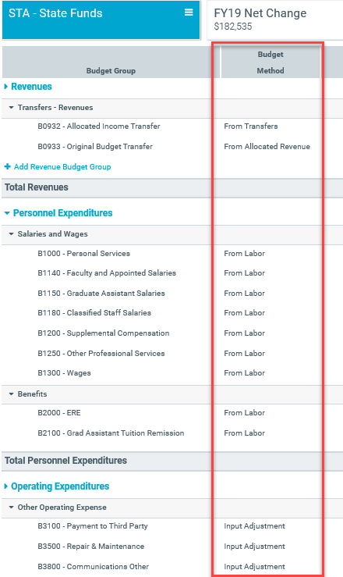
Budget Method
The method used for planning FY2020 through FY2023:
From Labor - the data for FY20 and FY21 is coming from the Labor Module; user input is required to plan years FY22 and FY23.
From Transfers - All data is coming from the TRANSFERS tab
From Allocated Revenue - the data for FY20 and FY21 is coming from the RCM planning module or loaded directly by the Office of Budget and Planning; user input is required to plan years FY22 and FY23.
Input Adjustment - Users input is required to plan current and future years.

Slide 16
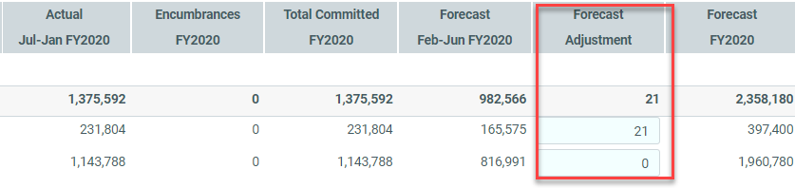
Forecast FY20 Revenues & Expenditures
The “Forecast Adjustment” column allows you to add to the Forecast Calculation to produce a total Forecast FY2020 figure. Forecast FY2020 = Actual Jul-Jan FY2020 + Forecast Feb-Jun FY2020 + Forecast Adjustment.

Slide 17
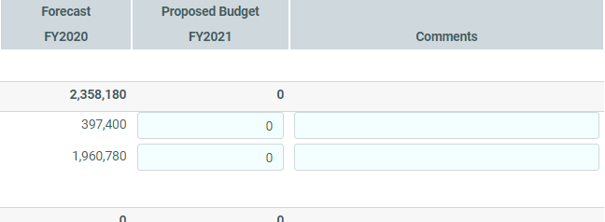
Propose Budget for FY21
Revenues & Expenditures
The “Proposed Budget” column allows you to create your Budget figures for FY2021 for both Revenues and Expenditures. This figure is what we call “zero base,” which means it will always default to $0 and you will be asked to enter the amount you are proposing. You can also annotate with Comments.

Slide 18

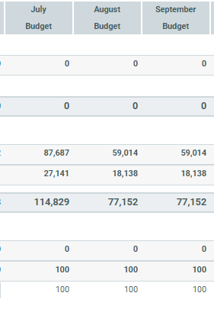
Propose Monthly Budgets for FY21
In the “Planning Months” view you can distribute your Proposed Budget FY2021 to months using a “Spread Method.” The only Spread Method we are turning on this year is “Even.” Let’s get used to the process and then get good at monthly budgeting.

Slide 19
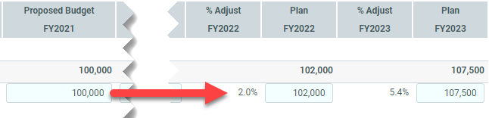
Create Plans for FY22 & FY23
FY22 and FY23 are “zero base” just as FY21 is, so enter your plan amounts and confirm the % change by reviewing the % Adjust columns.

Slide 20
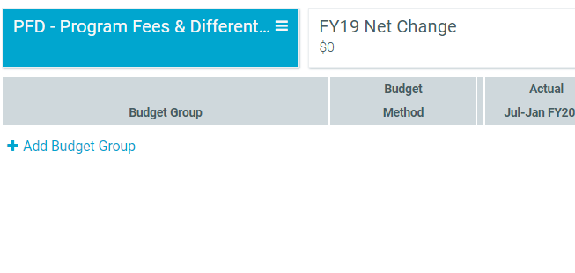
Add/Change Planning Funds
If you want to plan to a Fund that you have no historical actuals in you will see a blank form and you will need to add Budget Groups and Budget Objects to the form to enter your Forecast, Budget, and Plan data in for the newly added Planning Fund. See Next Sections for Additional Information.

Slide 21
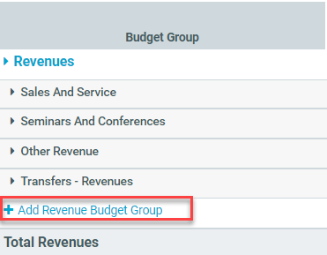
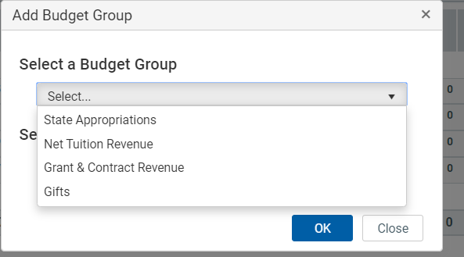
Adding a New Budget Group
If you want to plan for a new group of Budget Objects that do not have any historical actuals you will want to “+ Add Revenue Budget Group”

Slide 22
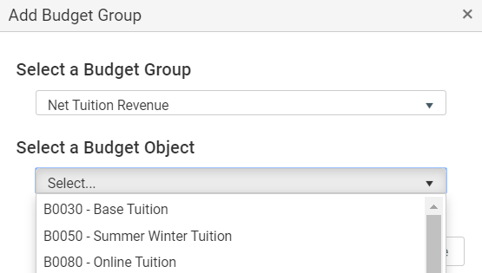
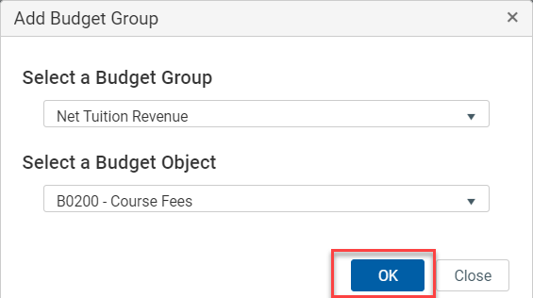
Adding a New Budget Group (cont.)
If you want to plan for a new group of Budget Objects that do not have any historical actuals you will want to “+ Add Revenue Budget Group”

Slide 23
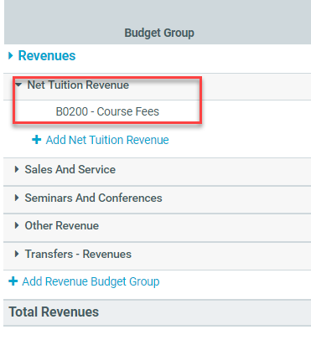
Adding a New Budget Group (cont.)
If you want to plan for a new group of Budget Objects that do not have any historical actuals you will want to “+ Add Revenue Budget Group”

Slide 24
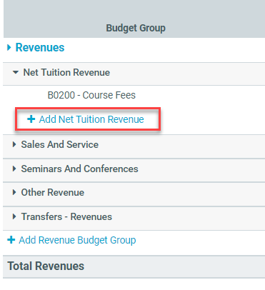
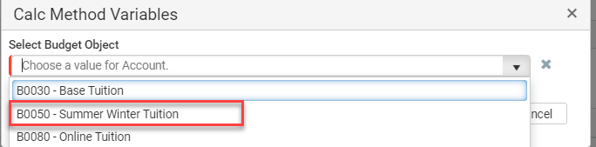
Adding a New Budget Object
Within a Budget Group you may want to add a new Budget Object. You do this by selecting the “+ Add…” icon within the appropriate Budget Group. You can perform both of these functions for both Revenues and Expenditures.

Slide 25
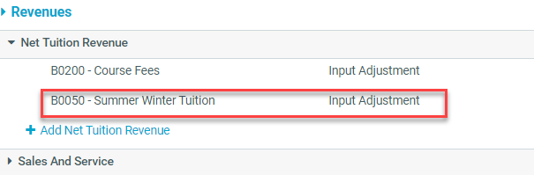
Adding a New Budget Object (cont.)
Within a Budget Group you may want to add a new Budget Object. You do this by selecting the “+ Add…” icon within the appropriate Budget Group. You can perform both of these functions for both Revenues and Expenditures.

Slide 26
Scenario
Your department will be getting a 2% budget cut in State Funds, effective FY22.
Notes:
Solution:
Select STA-State Funds
Select View and Out Years to edit FY 2022
In the Budget Group “Transfers-Revenue”, there should already be a Budget Object Code for B0933 Original Budget Transfer and an amount in the Proposed Budget FY 2021 column.
Scroll to the right and then calculate input an amount in the FY22 column that would equal the negative 2% impact.

Slide 27
Scenario
You are planning on replacing a piece of equipment in FY23 and it is estimated to cost $11,000, and it will be funded from State funds.
Notes:
Solution
Select STA-State Funds
Select View and Out Years to edit FY 2023
Scroll to the Other Operating Expenditures Budget Group and expand Other Operating Expense
Look for Budget Object Code B7600 - Capital. If the Capital Budget Group is not available:
Click on the “Add Operating Expenditure Budget Group” option
Select the Budget Group ‘Capital’ and the corresponding Budget Object B7600-Capital.
Scroll to the right and input $11,000 into the Plan FY 2023 column

Slide 28
Scenario
Option 1: You have a service center in your department. You have recently increased your rates by 4% and therefore hope to see a 4% increase in Sales and Services revenue overall. The new rates will be effective July 1, 2020.
Option 2: If your unit does not currently have any designated service center funds, assume you are launching a new service center on July 1, 2020 and you are projecting $125,000 in Sales and Services revenue the first year. Your rates will remain the same over the planning years but you expect to see business ramp up gradually.
Notes:
Solution:
Option 1:
Select SVC-Designated Service Center
Select View and Planning View since you are just updating for FY 2021. However, you can also update for FY 2021 if you select the View/Out Years.
In the Proposed Budget FY2021 column and in the Row B0390- Sales and Service, input the total sales and service revenue amount which would include the 4% increase. There is not a place on this row to input percentage change for FY 2021.
Option 2:
Select SVC-Designated Service Center
Select View and Out Years since we’ll plan for FY 2021-23.
Select the “Add Sales and Service” link to add a new revenue category. Select B0390-Sales and Service.
In the Proposed Budget FY 2021 column input the total sales and service revenue amount $125,000.
In the Plan FY 2022 and Plan FY 2023 columns, enter amounts to plan for a gradual ramp up in business.

Slide 29
Scenario
You are estimating an uptick in grant funding of $100,000 in direct costs in Fiscal Year 2022 and FY2023. Please plan for these revenues, expenditures, and associated F&A costs. Assume the direct costs only include software expenses. Assume an existing On Campus Research rate of 53.5% on F&A.
Notes:
Solution:
Select SPN - Sponsored Projects fund
Select View and Out Years
Revenues: use budget object B0300 - Grants & Contract Revenue and plan as follows:
input $153,500 in the Proposed Budget FY2022 column
input $153,500 in the Plan FY2023 colum
Expenditures: use budget object B4620 - software and plan as follows (within the Other Operating Expense budget group):
input $100,000 in the Proposed Budget FY2022 column
input $100,000 in the Plan FY2023 colum
F&A: use budget object B7950 - Grants and Contract F&A (located in Operating Expenditures, under the Indirect Expenditures budget group)
input $53,500 in the Proposed Budget FY2021 column
input $53,500 in the Plan FY2023 column
The total revenues must match expenditures for each planning year.

Slide 30
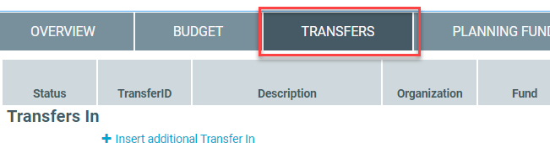
Transfers
Overview
The Transfers tab is designed to allow you to plan for changes to your transfers in and out:
Plan Transfers In from Organizations Within Your College/Division
Plan Transfers In from Organizations Outside Your College/Division
Plan Transfers Out to Organizations Within Your College/Division
Plan Transfers Out to Organizations Outside Your College/Division
Confirm Transfer To or From Other Organizations

Slide 31

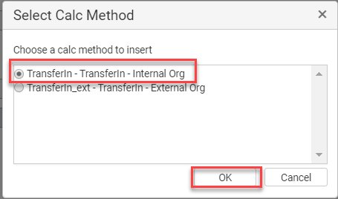
Planning Transfers In Within College/Div.
When adding a new planned Transfer you select “+ Insert additional Transfer In” and then “TransferIn - TransferIn - Internal Org”

Slide 32
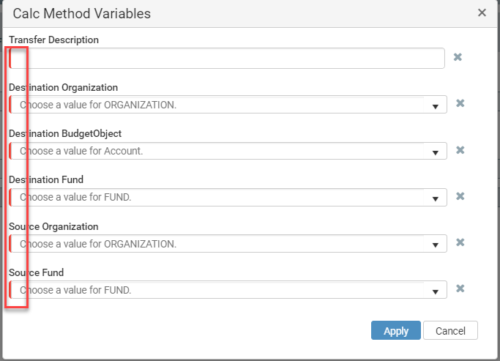
Planning Transfers In Within College/Div.
All fields are required, indicated by the red bar on the left-hand side of each drop-down

Slide 33
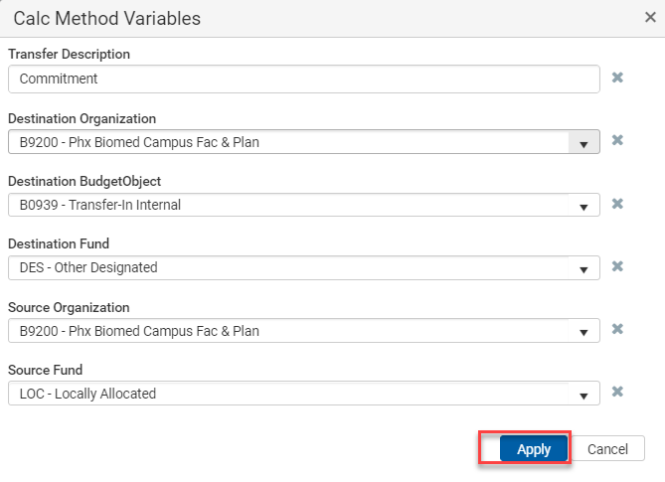
Planning Transfers In Within College/Div.
Complete all fields as appropriate and select Apply

Slide 34

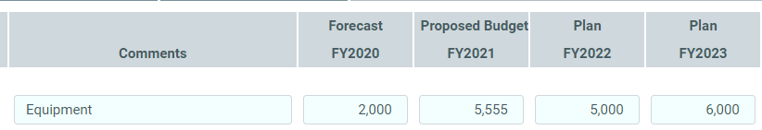
Planning Transfers In Within College/Div.
Confirm your planned Transfer In amounts by fiscal year and don’t forget to click save

Slide 35
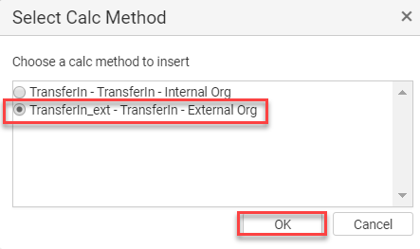
Planning Transfers In Outside College/Div.
Transfers In From Organizations Outside your College/Division are very similar, you simply update your Calc Method to choose “TransferIn-ext - TransferIn - External Org.” This will change your Available Source Organizations to all Organizations Outside your College/Division.

Slide 36
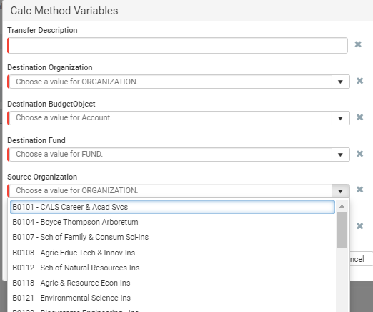
Planning Transfers In Outside College/Div. (cont.)
Transfers In From Organizations Outside your College/Division are very similar, you simply update your Calc Method to choose “TransferIn-ext - TransferIn - External Org.” This will change your Available Destination Organizations to all Organizations Outside your College/Division.

Slide 37
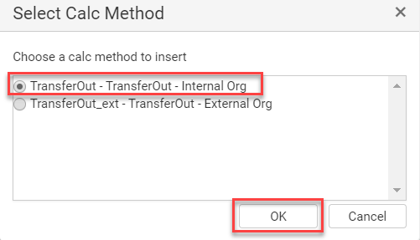
Planning Transfers Out Within College/Div.
For Transfers Out you repeat all the same previous steps, simply change your Calc Method to “TransferOut - TransferOut - Internal Org”

Slide 38
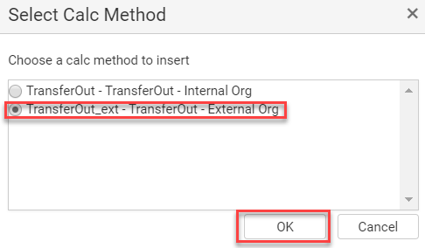
Planning Transfers Out Outside College/Div.
For Transfers Out you repeat all the same previous steps, simply change your Calc Method to “TransferOut - TransferOut - Extneral Org”

Slide 39
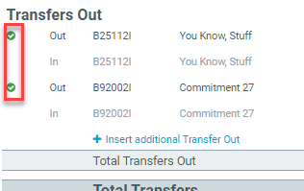
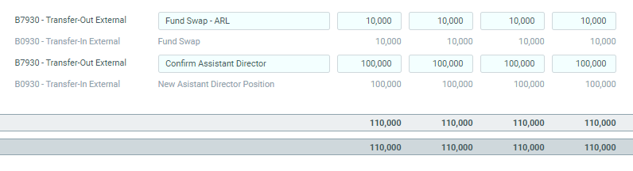
Confirming Transfers From Other Organizations
Both Organizations on the To and From Side of the Transfer need to confirm the exact amounts of both sides of the transfers for all Planning Years through FY2023. If all amounts align upon Save then you will see the red X replaced by the green Check.

Slide 40
Scenario
The Provost’s Office has agreed to support a strategic initiative in your department and will be transferring $65,000 in Designated Funds each year through FY22 (including the current year).
Notes:
Solution:
Go to “Transfers Tab”
Select ‘Insert additional Transfer In’
Selec Calc Method: ‘TransferIn_ext- TransferIn - External Org’
Complete the required fields displayed in the Calc Method Variables menu:
Transfer Description: enter project/initiative name
Destination Organization: select your org
Destination Budget Object: B0930 - Transfer-In External
Destination Fund: DES - Other Designated
Source Organization: B9902 - Office of the Provost
Source Fund - DES - Other Designated
Select ‘Apply’
Add comments (i.e. planned funds for FY20 through FY22 per funding agreement)
Enter $65,000 each year through FY22
Click on ‘Save’
The document has been routed to Org 9902 for approval, and the status will display a green checkmark once approved.

Slide 41
Final Case Study: You are responsible for entering the Operating Budget data into the new budget and planning tool for your department. You have met with your unit leadership and you are aware of the following financial trends and upcoming commitments:
Your FY20 and FY21 Personal Services forecast have already been entered into the labor module, but you still need to plan FY22 and FY23. You are expecting two full-time staff members earning $75K and $60K annually to retire by the end of FY21 and are not planning to replace these positions.
Due to declining indirect cost returns at the University, you are anticipating your Allocated funds to decrease by 2% in FY22, and 2% again in FY23. FY20 Allocated funds have already been distributed. (*Allocated funds= IDC Allocated, Allocated Admin Service Charge, and Allocated Retained Fees)
You are planning to do $50,000 in office renovations in FY21
You have just been informed that both ASC on Revenue and ASC on Expense are both increasing by 1% beginning in FY21
Software and Supplies are both anticipated to increase 4% annually for the next three years
Your department has committed to transferring $10,000 annually to the College of Education for the next three years beginning in FY21 to support a joint project.
Notes:
Solutions
Change Planning View to Out Years.
$75k plus $60k is $135k, plus $42,390 in 31.4% ERE is $177,390 rounded up to $177,500. You enter a negative $177,500 against whatever your planned FY21 Salary is for both FY22 and FY23
2.
Select LOC-Locally Allocated Planning Fund
Change Planning View to Out Years.
Calculate what 2% reduction is to your FY21 Proposed Budget in B0933 Original Budget Transfer under Transfers-Revenue and enter that amount in Plan FY2022
Repeat for 2% on top of this figure for FY2023
3.
Under the Budget Group Other Operating Expenses you could enter the $50,000 in the FY21 Forecast Adjustment column most likely as B5700 Non-Capitalized Equipment and/or B3500 Repair & Maintenance
4.
Calculate your FY18 and FY19 ASC on Expense and ASC on Revenue as a percentage of Total Operating Expenditures and Total Revenues respectively to determine your blended ASC rate. Add 1% to each of these rates and apply to your Total Expenditures and Revenues for all plan years of FY21-23.
Select “add other operating expenses”, select “Indirect Expenditures” for Budget Group and “B7955-ASC on Revenue” and then “B7956-ASC on Exp”. Select OK to add as row. This step assumes you are adding these new object codes. Otherwise, these object codes will display in the “Indirect Expneditures” Budget Group section.
5.
Under the Budget Group Other Operating Expenses find the activity for B4620 Software and B5100 Supplies and calculate the 4% growth factor for each Budget Object. Input the amount in the out years.
6.
Select the Transfers tab. Select “Insert additional Transfer Out”
In the Calc Method select “TransferOut_ext-Transfer Out-External Org” and select OK.
In the Calc Method Variable
Transfer Description: enter project/initiative name
Source Organization: Select your organization
Source Fund: Select a fund such as DES-Other Designated
Source Budget Object: B07930 - Transfer Out External
Destination Organization: DES - Other Designated
Source Organization: B3201-Education-Deans Office
Destination Fund: Select a fund such as DES-Other Designated as an example
Select “Apply”
Enter $10,000 in FY21-23 and save.

Slide 42
Review Data
Use the Planning Fund Summary and Budget Object Summary to Ensure all Your Plan Data is Correct

Slide 43
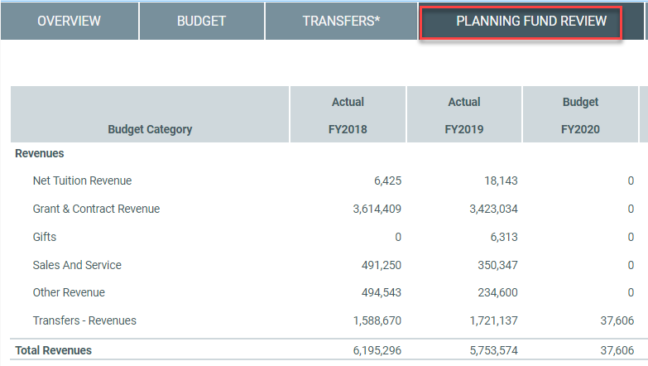
Click the Planning Fund Summary tab to review your aggregated data by Planning Fund.

Slide 44
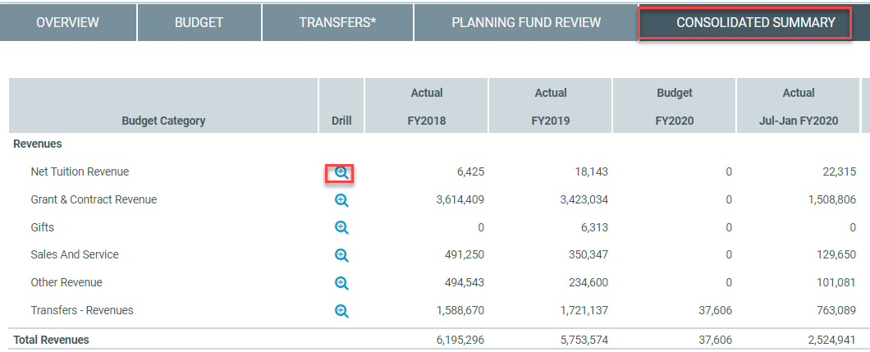
Click the Consolidated Summary tab to review your aggregated for All Funds. You can select the “Drill” icon to see the data making up a particular row and UAccess Financials transaction detail.

Slide 45
Submit Form
How to submit your form & what happens next
(still need slides when routing is available)

Slide 46
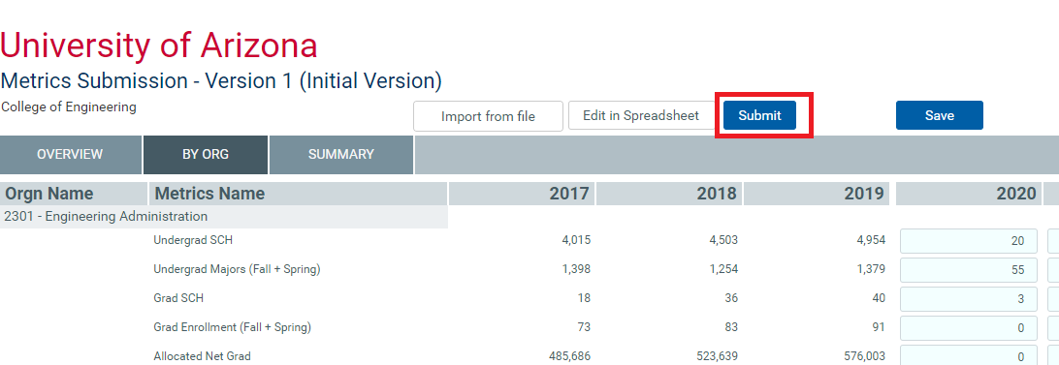
When data entry is complete and reviewed you can select submit.

Slide 47
Approve Form
If you have a College Approver role, then they will need to Approve as well
(still need slides when routing is available)

Slide 48
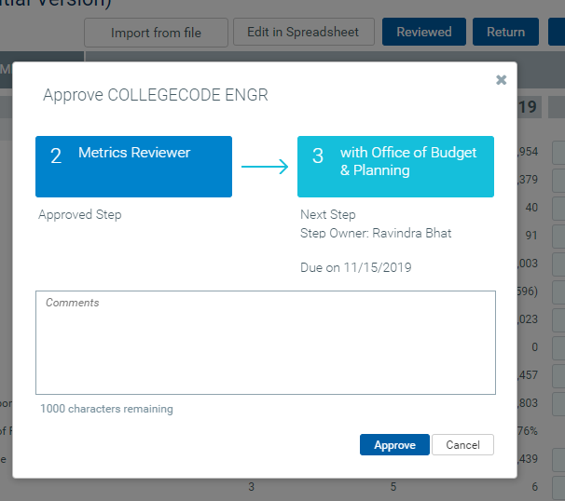
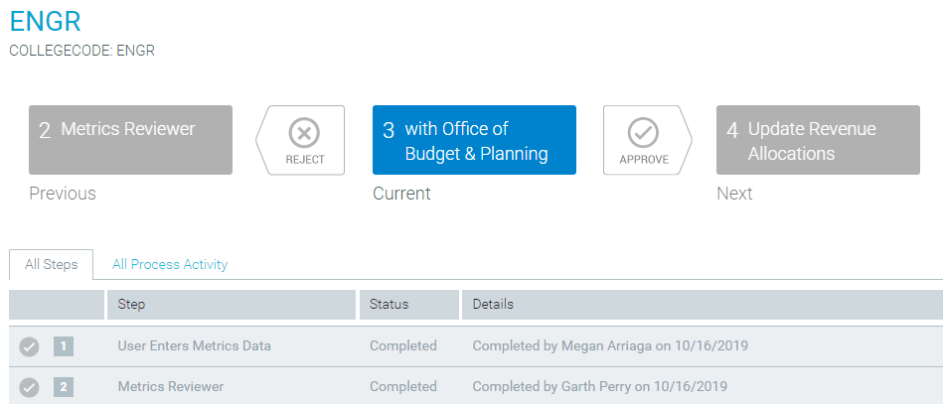
Final Status will Read “with Office of Budget & Planning” when complete.

Slide 49
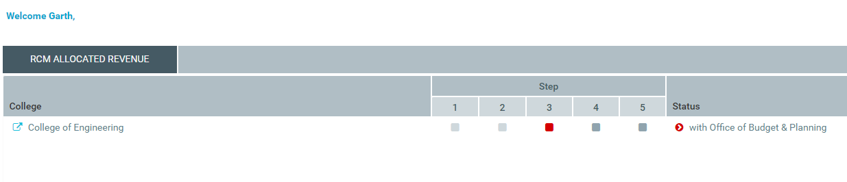
Final Status will Read “with Office of Budget & Planning” when complete.

Slide 50
Congrats, you’re done!

