Slide 1
Labor Planning
Training
Personal Services & Employee Related Expenditures (ERE)

Slide 2
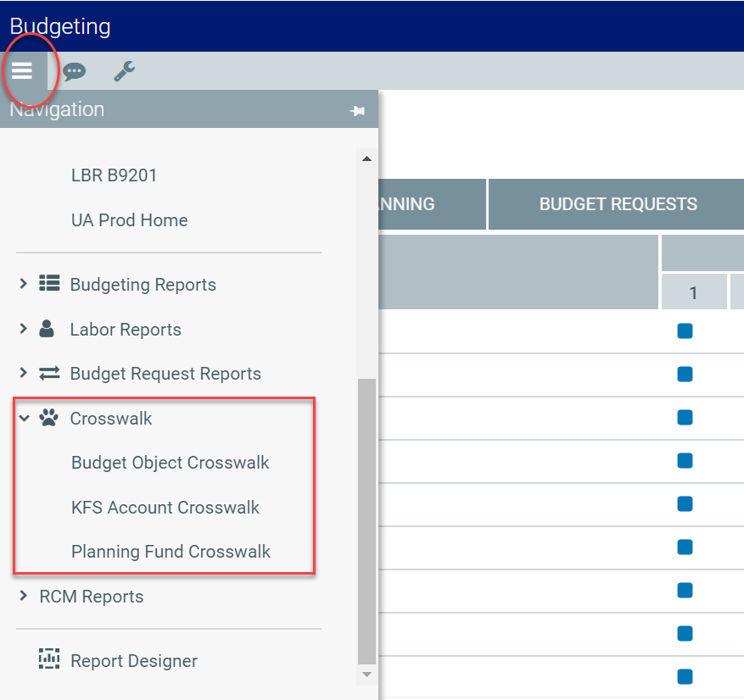
Note: Budget Object, KFS Account, and Planning Fund crosswalk reports are available in Axiom.

Slide 3
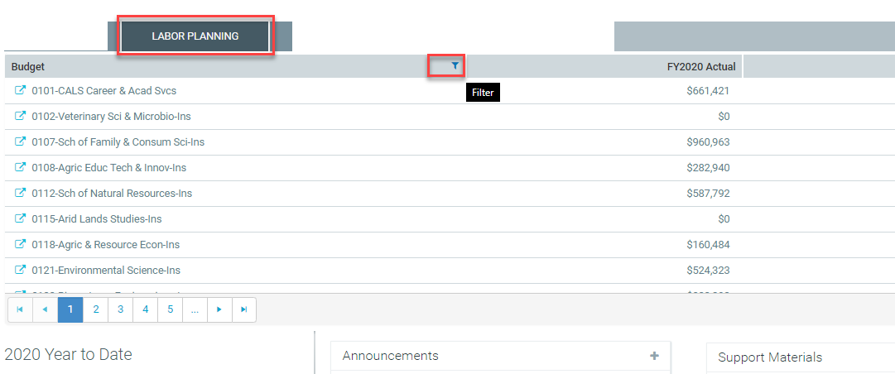
Logging In
Log in using your NetID
Main Screen will display Labor Plan File Status
Note: In the Budget and Planning tool, a “Plan File” is the file associated with a specific org or college

Slide 4
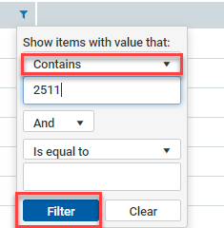
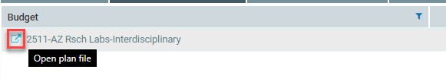
Use the Filter Function to Select your Plan File
Note: In the Production system you will only see Organization codes you have been provisioned to have access to

Slide 5
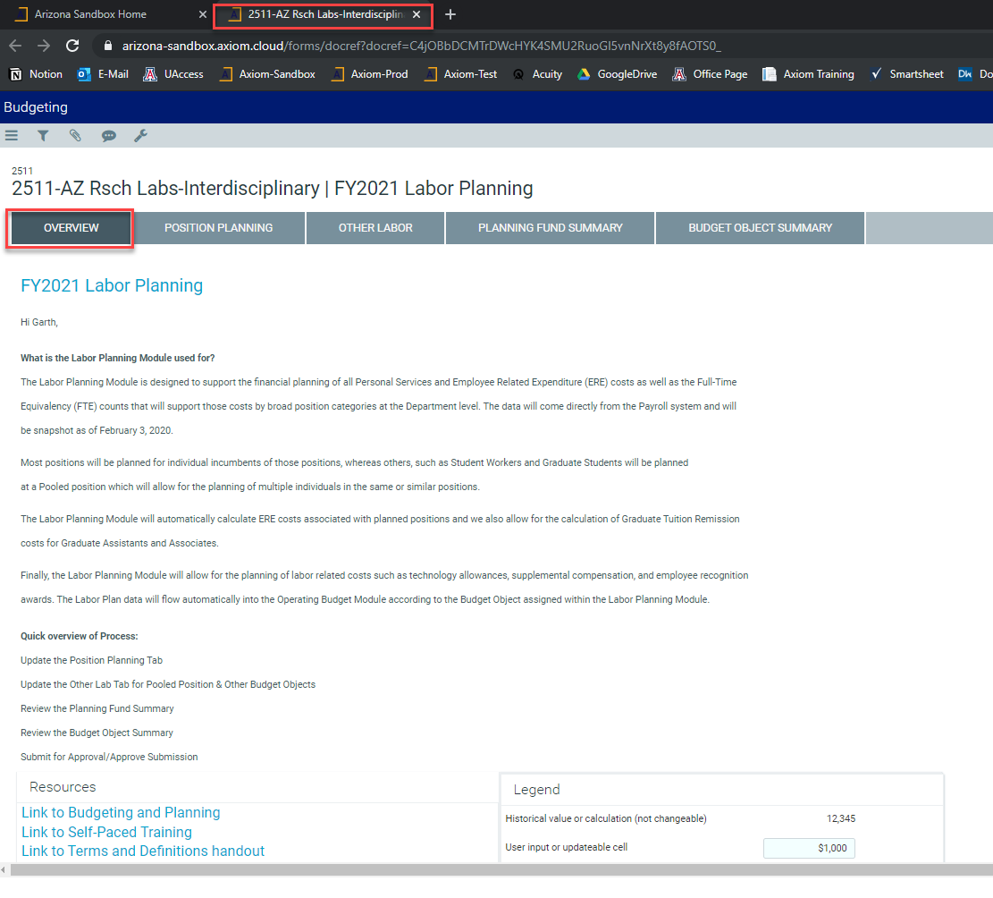
Review “Overview” tab
Read through the overview tab for information about how and why you will plan for Personal Services and ERE:
Make note of the Resources section for additional documentation and information that can assist you
Be aware of the Legend, icons, and formatting pertinent to Labor Planning
Also of note is that your Plan File has opened in a new browser tab

Slide 6

Position Planning

Slide 7
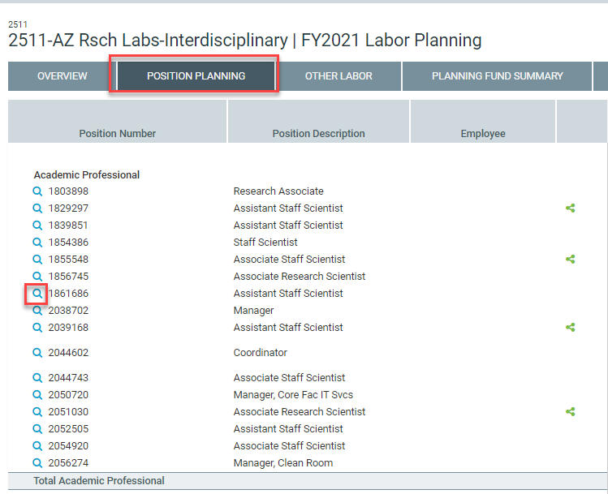
Position Planning
Overview
The Position Planning tab is designed to allow you to plan for a variety of changes to your positions:
Snapshot Data Pull
Scrolling
Column Headers
Shared Positions
Icons

Slide 8
Position Planning
The Position Planning tab is designed to allow you to plan for a variety of changes to your positions:
Plan an end date to an existing position to zero out the budget/plan for that individual
Plan for 7/1/20 effective Merit, Market, Equity, or Other salary adjustments (positive or negative)
Change the position funding distribution plan (Organization or Planning Fund) for existing or new positions
Change Monthly Distribution to 9 Months
Plan for new positions

Slide 9
Use Magnifying Glass Icon to Select a Position to change planning attributes

Slide 10
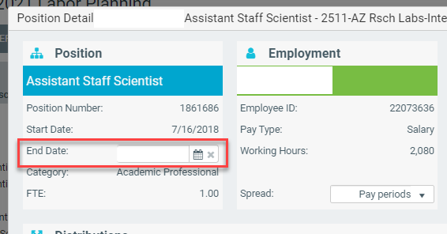
Plan to End a Position
Selecting an End Date in the first blue panel of the Position Detail pop-up will zero out the plan data for salary/wage and ERE for the selected position.

Slide 11
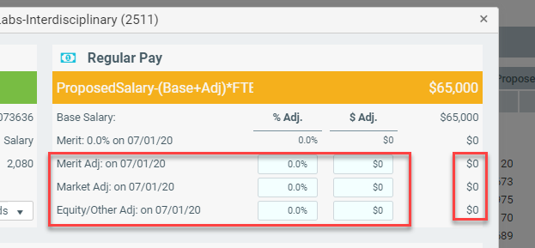
Plan for a Salary/Wage Adjustment
Entering data in the blue boxes of the orange panel of the Position Detail pop-up will increase or decrease the plan data for salary/wage and ERE for the selected position.

Slide 12
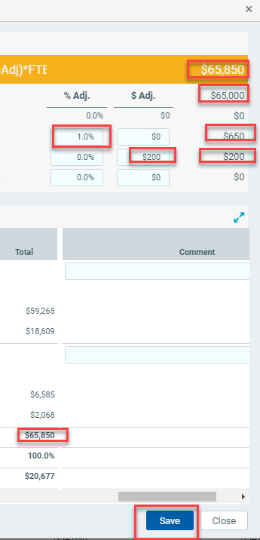
Plan for a Salary/Wage Adjustment
You can select a % Adjustment, a Dollar ($) Adjustment, or both. As you enter you will notice the column on the right updates to reflect your change, as does the Orange bar revised Proposed Salary and the total calculated salary row near the bottom. Don’t forget to Save!

Slide 13
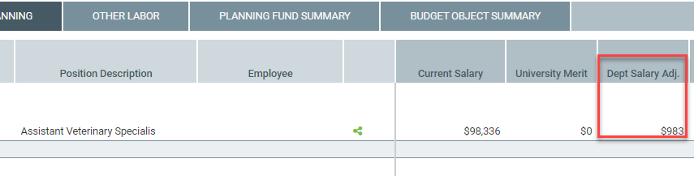
Plan for a Salary/Wage Adjustment
Once you save your Salary Adjustments, they will also be reflected on the Position Planning summary screen. This screen is also often referred to as the “Roster” screen.

Slide 14
Scenario
Employee X is to receive a 3% merit increase on July 1, 2020. The increase is only to apply to the employee’s base salary. Assume the employee also receives a $20,000 admin stipend.
Notes:
Solution:
Select the “Position Planning” tab
Open the Position Detail by selecting an employee’s magnifying glass icon
manually subtract $20K from the Proposed Base Salary and then multiply that amount by 3%
Input this amount in the “$ Adj” column in the “Merit Adj” row
Click the “Save” button which will take you back to the roster list in the position planning tab

Slide 15
Scenario
Your department head is returning to a faculty position on July 1, 2020. They currently receive an admin stipend of $20,000.
Notes:
Solution:
Select the “Position Planning” tab
Open the Position Detail by selecting an employee’s magnifying glass icon
Input a negative $20K in the “$ Adj” column in the “Equity/Other Adj” row
Click the “Save” button which will take you back to the roster list in the position planning tab

Slide 16
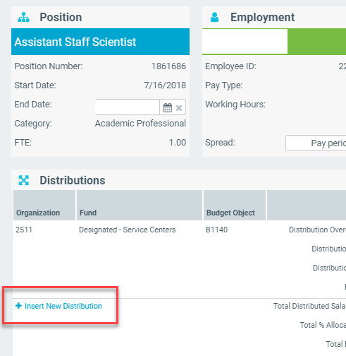
Plan for a Position Funding Distribution Change
To add a new distribution for a selected position you will find a “+ Insert New Distribution” icon below your last row of current distribution data.

Slide 17
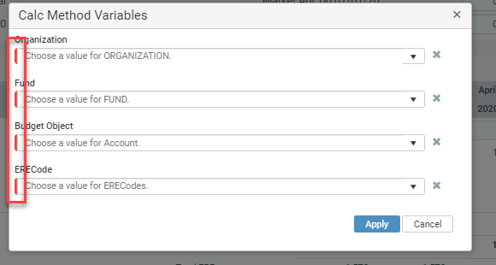
Plan for a Position Funding Distribution Change
When you select to add a new distribution you will be asked to complete all the required planning dimensions needed to add the new distribution row. As indicated by the red side-bar, all these planning dimensions are required before you select “Apply.”

Slide 18
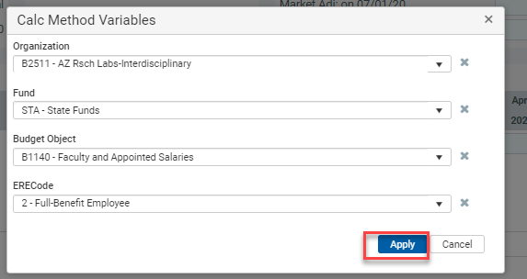
Plan for a Position Funding Distribution Change
Select your desired combination of planning dimensions and click Apply

Slide 19
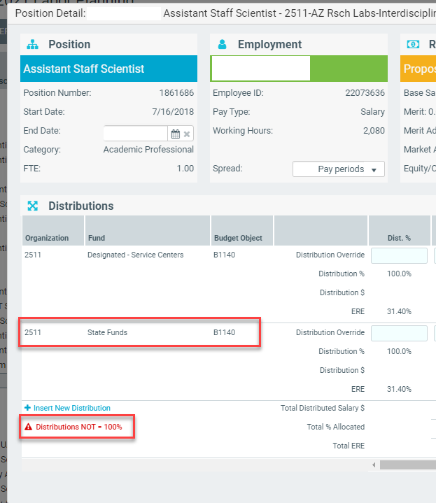
Plan for a Position Funding Distribution Change
Your new distribution row will always be added as a new 100% distribution and you will receive a warning icon indicating your position is now over-distributed.

Slide 20
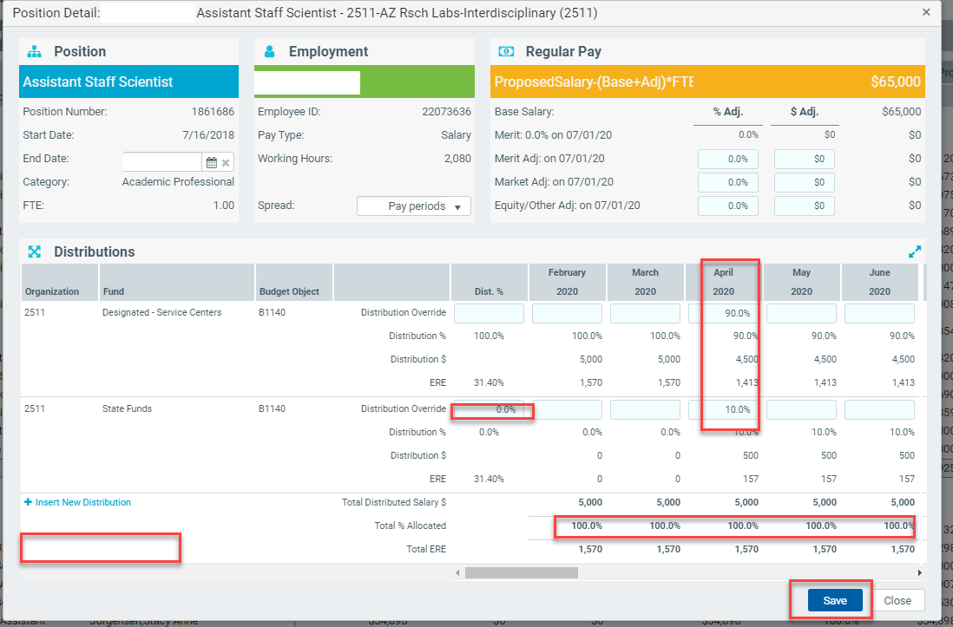
Plan for a Position Funding Distribution Change
In order to clear the over-distribution error in the lower left-hand corner of the Position Detail panel you will want to update the distribution to be effective in the month you want to reflect the change and ensure the “Total % Allocated” row equals 100% for all planning months planned. Don’t forget to Save!

Slide 21
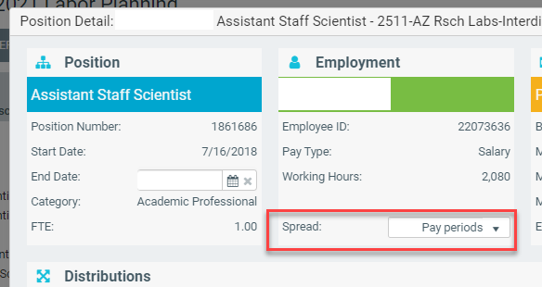
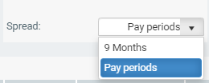
Change Monthly Distribution to 9 Months
In order to change a 12 month payroll distribution to a 9 month distribution you will select the “Spread” drop-down in the second green panel of the Position Detail screen and change the Spread from Pay periods to 9 months.

Slide 22
Scenario
You have a faculty member who is currently funded 100% from a sponsored grant. The unit plans to split the salary 50% grant, 25% cost share with gift funds, and 25% non-cost share with designated funds beginning October 1st, 2020.
Notes:
Solution:
Select the “Position Planning” tab
Open the Position Detail by selecting an employee’s magnifying glass icon
Click on the “Insert New Distribution” link
Select the required fields, “Organization”, “Fund”, “Budget Object”, “ERE Code”
Select “Other Designated” for the Fund and click “Apply”
Select the required fields, “Organization”, “Fund”, “Budget Object”, “ERE Code”
Select “Other Restricted” for the Fund and click “Apply”
Scroll to the October 2020 column and input 50% for the original distribution funding row, 25% Other Designated, 25% Other Restricted, ensure the funding is 100% and 0% for the distributions preceding October to clear the over-distribution error
Click “Save” to take you back to the Roster page in the Position Planning tab

Slide 23
Scenario
Employee X plans to retire on May 31, 2021. As part of the phased retirement program, the employee plans on reducing her FTE to .65 effective December 2020.
Notes:
Solution
Step 1: End the Position
Select the “Position Planning” tab
Open the Position Detail by selecting an employee’s magnifying glass icon
In the end date box, input December 31, 2020
In the distribution section of the position detail, you’ll notice how the salary amounts zero out beginning January 2021
Click on the “Save” button. Position will reflect in the roster page on the Position Planning tab
Step 2: Change the FTE
Still in the “Position Planning” tab, click on the “Add Position” in the top right corner of the screen.
Input all required fields
Use an FTE of .65, a start date of January 1, 2021 and an end date of May 31, 2021
Click on the “Save” button. Position will reflect in the roster page on the Position Planning tab

Slide 24

Adding a New Position
To add a new planned position you will select the Add Position icon in the upper right of the Position Planning Summary/Roster screen

Slide 25
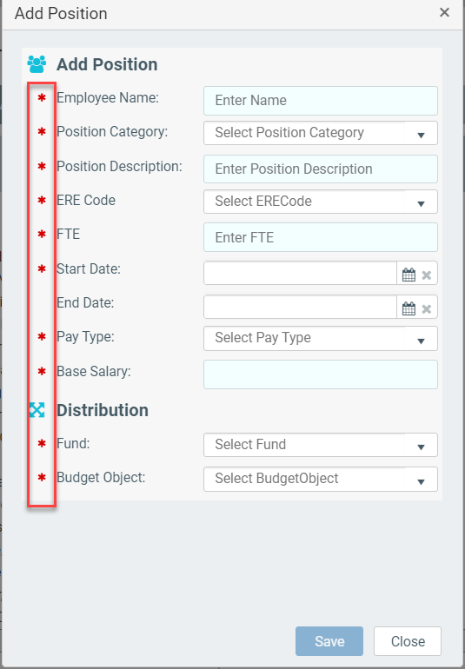
Adding a New Position
All required fields to add a new position are indicated with a Red Asterisk

Slide 26
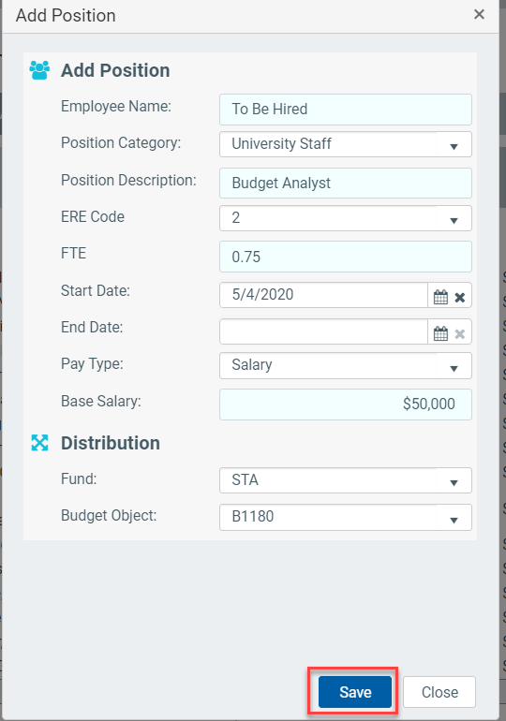
Adding a New Position
Complete all required fields and do not forget to click Save

Slide 27
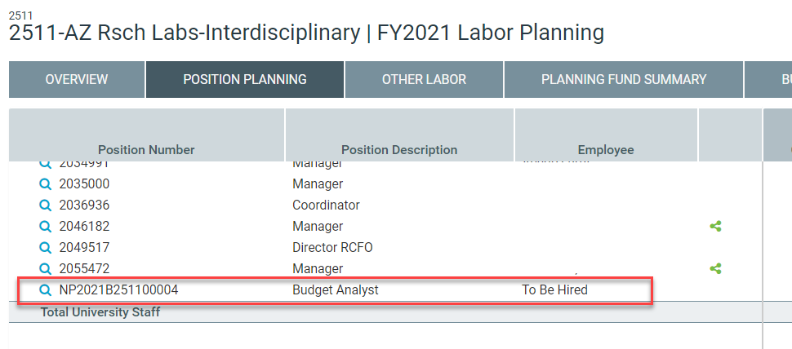
Adding a New Position
Ensure the new position has been correctly saved to your Roster

Slide 28
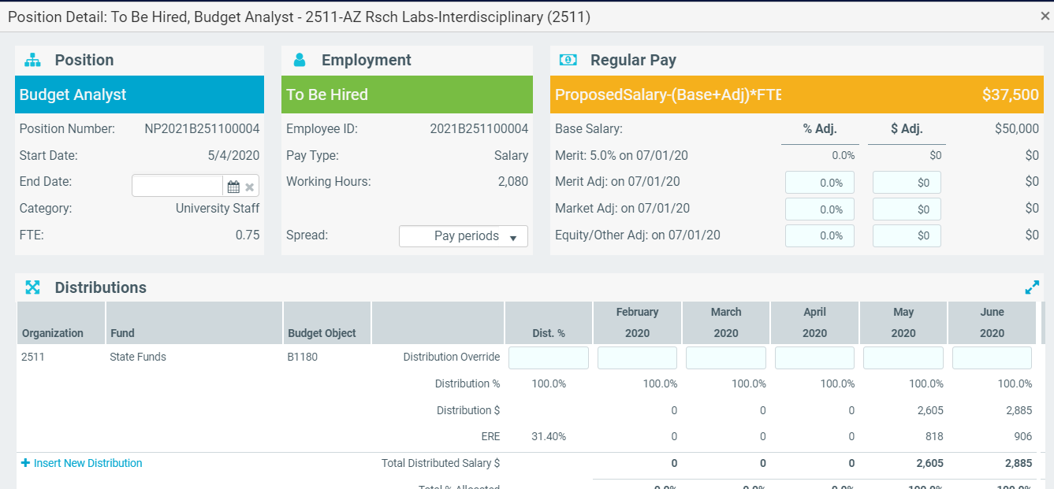
Adding a New Position
You will notice you can then plan all the same panels and distributions for new positions as you can existing positions

Slide 29
Scenario
Your department is planning to hire a new Associate Dean with an anticipated start date of July 1, 2020. The annualized salary will be $150,000 and will be paid with State funds.
Notes:
Solution:
Select the “Position Planning” tab
Click on the “Add Position” in the top right corner of the screen.
Input all required fields
Use Associate Dean for the Position Description, a start date of July 1, 2020, no end date, $150K for base salary, and State Funds for the Fund
Click on the “Save” button. Position will reflect in the roster page on the Position Planning tab

Slide 30
Scenario
Your unit is looking to fill a Director position by December 1, 2020. Meanwhile, one of your faculty was asked to serve as interim director starting July 1, 2020. The assignment comes with a stipend of $6,000. In addition to the stipend, your faculty will be receiving a 5% merit increase of base salary.
Notes:
Solution:
Part 1: Budget a 5% merit increase for faculty
Select the “Position Planning” tab
Open the Position Detail by selecting an employee’s magnifying glass icon
Input 5% as .05 in the “% Adj” column in the “Merit Adj” row
Click on the “Save” button. Position will reflect in the roster page on the Position Planning tab
Part 2: Budget a $6K stipend to same faculty
Still in the “Position Planning” tab, click on the “Add Position” in the top right corner of the screen.
Input all required fields
Use same position category as faculty person, base salary should be $6K, start date is July 1, 2020, end date is Dec 1, 2020
Do not enter end date, because stipend is for a fixed amount and an end date will prorate the amount by month
Click on the “Save” button. Position will reflect in the roster page on the Position Planning tab
Part 3: Budget a new director position effective December 1, 2020
Still in the “Position Planning” tab, click on the “Add Position” in the top right corner of the screen.
Input all required fields
Start date is December 1, 2020, no end date is needed
Click on the “Save” button. Position will reflect in the roster page on the Position Planning tab
Step 3: Add a new position for Director starting Dec 1st assuming you will fill the position and input required field

Slide 31
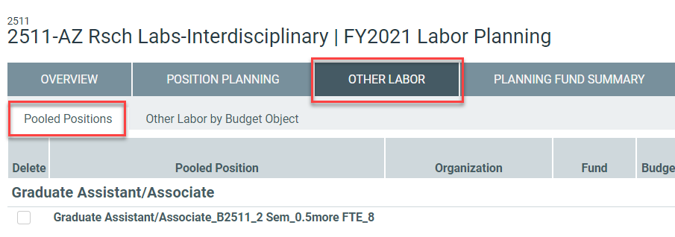
Pooled Position Planning
The Pooled Position Planning tab under Other Labor is designed to allow you to plan for a variety of changes to your pooled positions:
Add a New Pooled Position
Add a New Funding Distribution to an Existing Pooled Position
Delete an Existing Pooled Position
Delete an Existing Funding Distribution

Slide 32
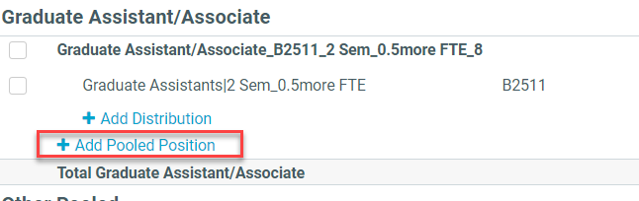
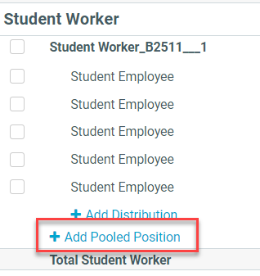
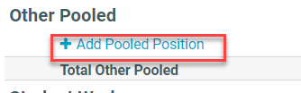
Adding a New Pooled Position
To add a new Pooled Position you simply need to select which type you are adding (GA, Student, or Other) and select the Appropriate “+ Add Pooled Position” Icon below each grouping

Slide 33
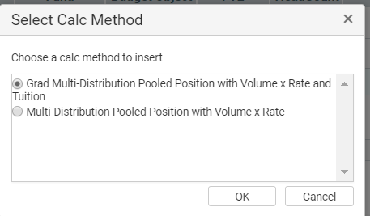
Adding a New Pooled Position
To add a new GA Pooled Position on the “Select Calc Method” screen be sure to select the “Grad Multi-Distribution” option as this will allow for Tuition Remission Calculations to be created. If you are adding a Student or Other Pooled Position select the regular “Multi-Distribution” option.

Slide 34
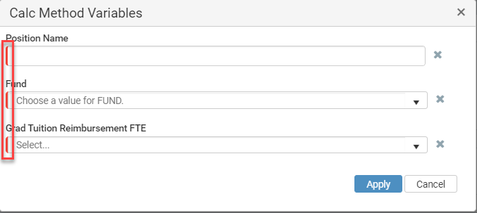
Adding a New Pooled Position
As with single-incumbent “Roster” positions, the red sidebar will indicate mandatory planning dimensions to be completed.

Slide 35
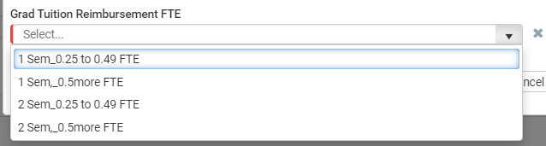
Adding a New Pooled Position
For GA Positions you will need to indicate whether the GAs are being hired for 1 Semester or 2 and whether they will be less than .50 FTE or .50. The reason you need to make this selection is that the Budget and Planning tool will then automatically calculate the Tuition Remission costs for these Pools based on these rules set by the Grad College and based on existing or planned tuition rates.

Slide 36
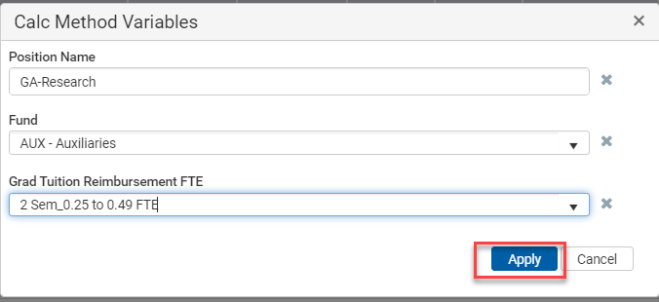
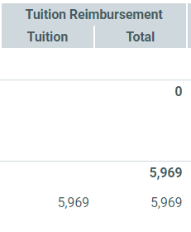
Adding a New Pooled Position
One possible scenario you could plan for is a 2 Semester Research GA that is .33 FTE. After you select “Apply” for this new Pooled Position and enter the salary amounts you can see how it would display to the right, including the Tuition Remission Calculation for the next year.

Slide 37
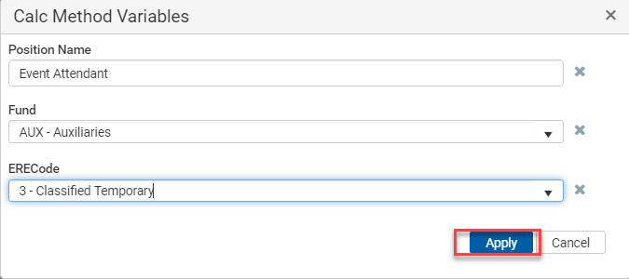
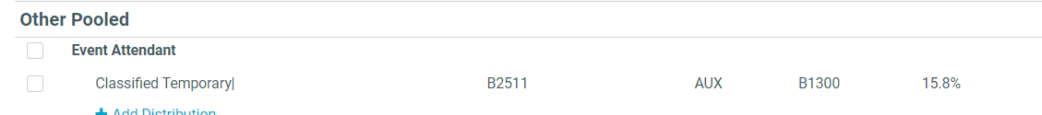
Adding a New Pooled Position
Here is another possible scenario for an “Other Pooled Position” which would be an Event Attendant.

Slide 38
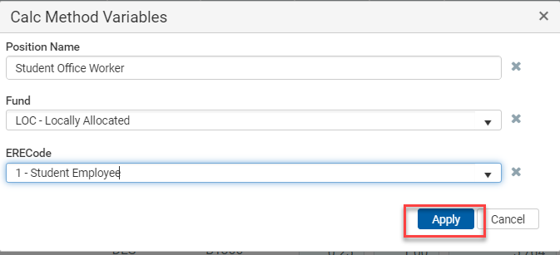
Adding a New Pooled Position
And another example, this time of a possible Student Pooled Position

Slide 39
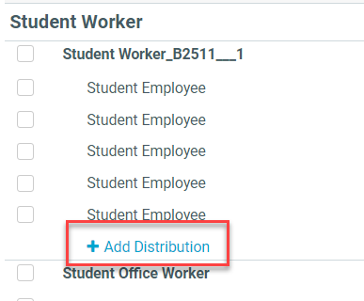
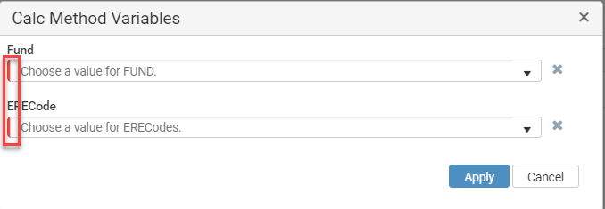
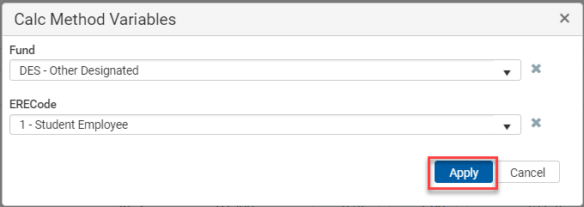
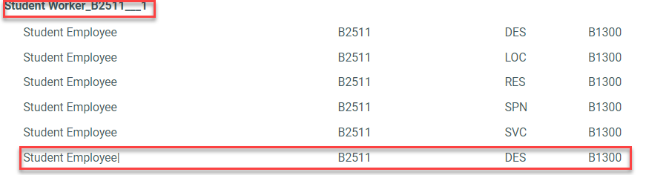
Adding a New Pooled Position Distribution
Adding a new funding distribution simply adds a row to an existing pooled position with a new combination of planning dimensions

Slide 40
Scenario
Your unit is planning on filing 10 Student Workers @ .25 FTE each on April 2020 at $12/hour.
Notes:
Navigate to the Other Labor>Pooled Positions Tab
Under the Student Worker Pooled Position Category select Add Pooled Position, select the non-GA Multi-Distribution, and enter funding
Enter an FTE of 2.5 (10 * .25) a HC of 10 and Avg Base Salary of $24,960 ($12 * 2,080 hrs) *In the module, the HC is information and is not part of the calculation.
Enter a negative adjustment of ($10,400) which is 2/5ths of the remaining planning period to reduce February and March from the February - June Plan, so Feb-June = $26,000 and 40% of that is $10,400
Don’t forget to save!

Slide 41
Scenario
Your unit plans on hiring two graduate students for FY21:
Grad Research Assistant for Lab X at $47,000, .50 FTE for fall funded from Sponsored funds
Grad Teaching Assistant to teach during fall and spring, at $47,000, .25 FTE, funded from Designated-Other funds
Notes:
Navigate to the Other Labor>Pooled Positions Tab
Under the Graduate Assistant/Associated Pooled Position Category select Add Pooled Position, select the GA Multi-Distribution, and enter funding of SPN-Sponsored for the first student and DES-Designated for the second
Be sure to select 1 semester and .50FTE for the first student and 2 semesters and .25-.49 for the second student.
Enter 1 HC for both students.
Don’t forget to save!

Slide 42
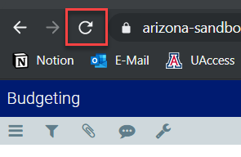

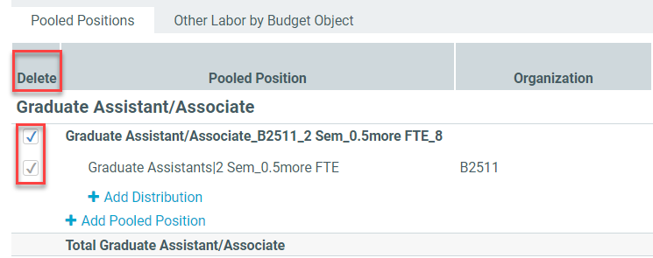
Deleting a Pooled Position or Distribution
In order to delete an existing distribution row you will select the Delete box next to the position or distribution and then click the Save button and then the Refresh button on your browser

Slide 43
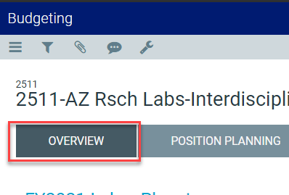
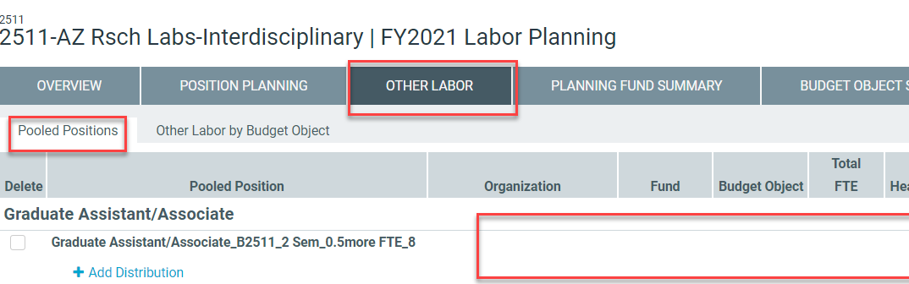
Deleting a Pooled Position or Distribution
Unfortunately Refresh in the Budget and Planning tool will take you back to the Overview tab in all Modules, including Labor Planning, so you will need to navigate back to Other Labor and Pooled Positions to see your deletion changes take effect

Slide 44
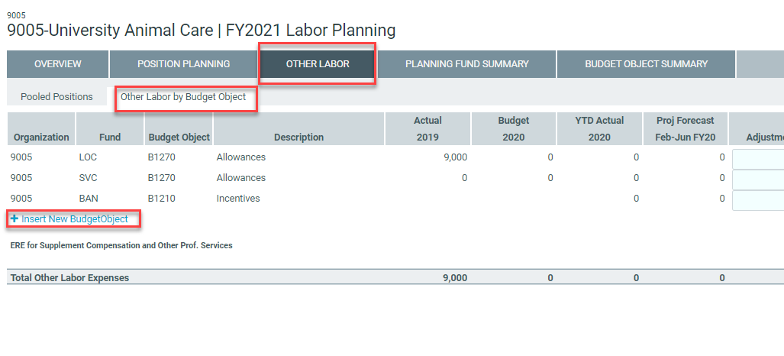
Other Labor by Budget Object
The Other Labor by Budget Object Planning tab under Other Labor is designed to allow you to plan for a variety of changes to your Personal Services budget by Budget Objects of:
Supplemental Compensation
Other Professional Services
Incentives
Employee Recognition Awards
Allowances

Slide 45
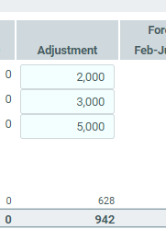
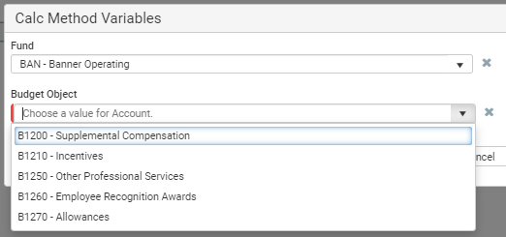
Other Labor by Budget Object
Simply select “+Insert New Budget Object” and then complete both mandatory planning dimensions of Fund and Budget Object to add, enter your amounts, and don’t forget to save.

Slide 46
Scenario
An employee in your department has gone on temporary assignment in another college for the next three months. In order to compensate an existing employee for taking on additional work during this period, you want to offer them $5,000 in Supplemental Compensation for the period from February 15, 2020 to May 15, 2020 using Other Designated funds.
Notes:
Solution:
Select the “Other Labor” tab and then the “Other Labor by Budget Object” tab
Select the “Insert new budget object” link
Select “Other Designated” for the Fund and select Budget Object “B1200-Supplemental Compensation”, then click “Apply”
Enter $5,000 in Adjustment column for FY20 (just to the right of the “Proj Forecast Feb-June FY20” column). Data will save back to the “Planning Fund Summary” and “Budget Object Summary” tabs
Dates not relevant to the fixed $5,000 plan amount

Slide 47
Scenario
Your unit plans on hiring a new Director by December 1, 2020 at annualized salary of $120,000 using Allocated IDC funds. The incumbent will also be receiving a $7,000 moving allowance (moving allowances are taxable income and processed through payroll).
Notes:
Solution:
Part 1: Budget for the new Director effective December 1, 2020
Select the “Position Planning” tab
Click on the “Add Position” in the top right corner of the screen.
Input all required fields
Start date is December 1, 2020, no end date is needed
Choose “Locally Allocated” for the Fund
Click on the “Save” button. Position will reflect in the roster page on the Position Planning tab
Part 2: Budget for the $7,000 Moving Allowance
Select the “Other Labor” tab and then the “Other Labor by Budget Object” tab
Select the “Insert new budget object” link
Select “Locally Allocated” for the Fund and select Budget Object “B1270-Allowances”, then click “Apply”
Input the $7,000 in the “Adjustment” column for FY21 (Just right of the Budget 2021 column)

Slide 48
Review Data
Use the Planning Fund Summary and Budget Object Summary to Ensure all Your Plan Data is Correct

Slide 49
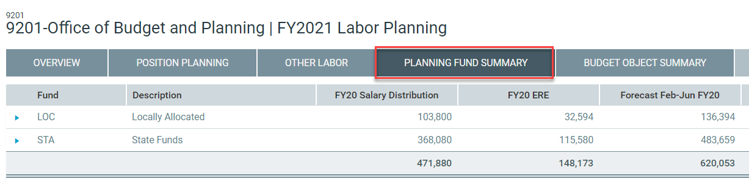
Click the Planning Fund Summary tab to review your aggregated data by Planning Fund.

Slide 50
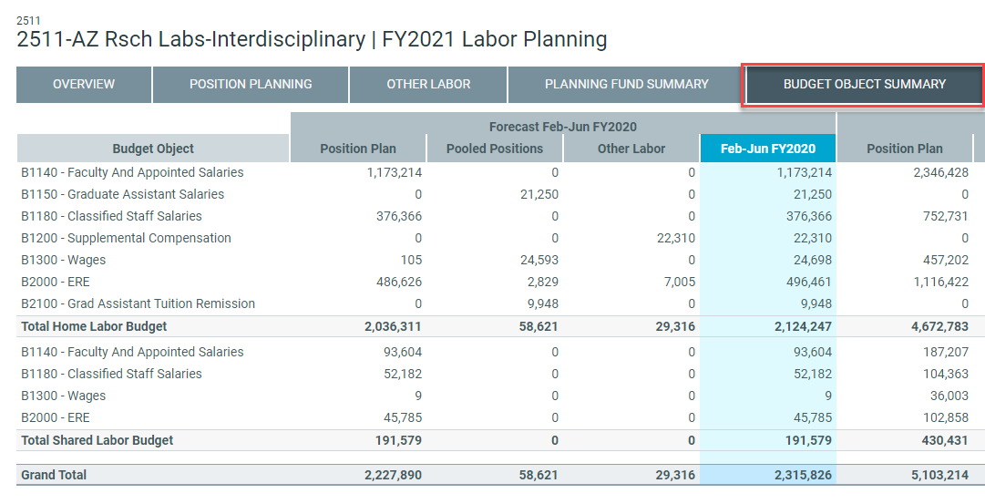
Click the Budget Object Summary tab to review your aggregated data by Budget Object.

Slide 51
Submit Form
How to submit your form & what happens next
(still need slides when routing is available)

Slide 52
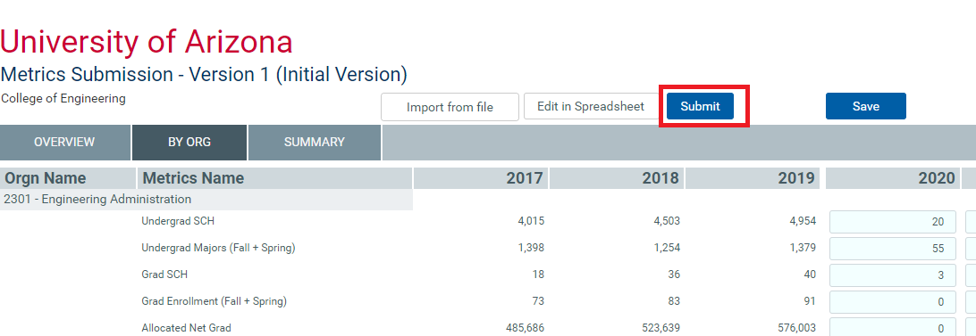
When data entry is complete and reviewed you can select submit.

Slide 53
Approve Form
If you have a College Approver role, then they will need to Approve as well
(still need slides when routing is available)

Slide 54
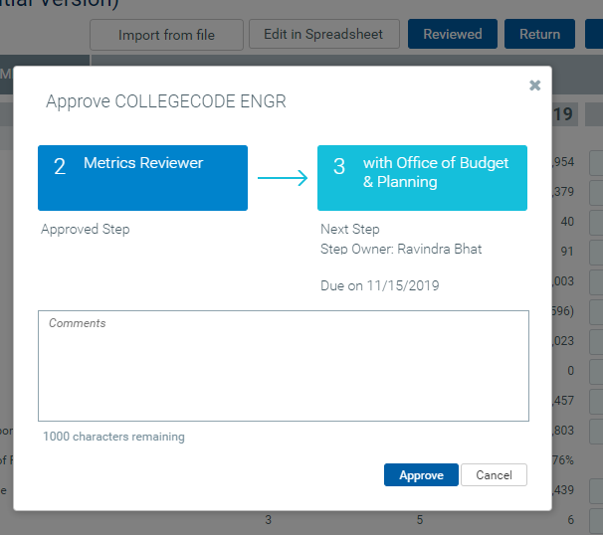
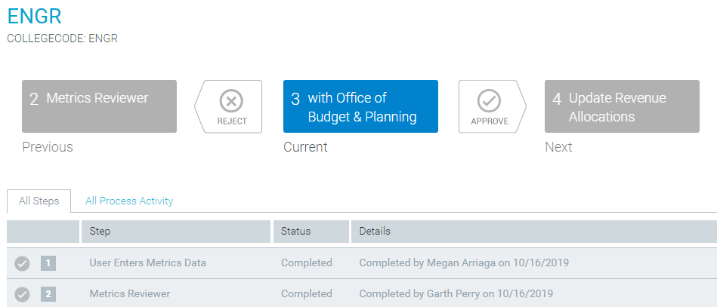
Final Status will Read “with Office of Budget & Planning” when complete.

Slide 55
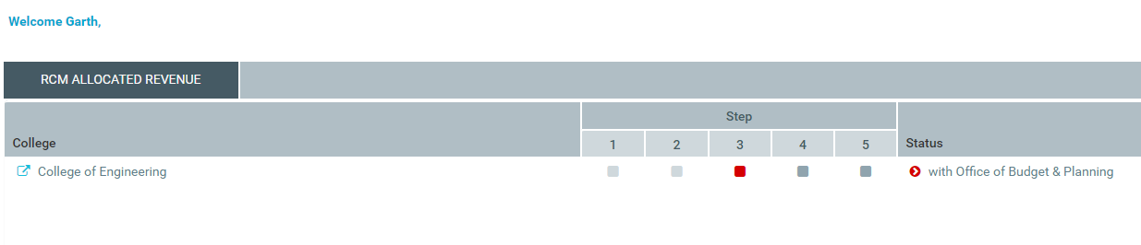
Final Status will Read “with Office of Budget & Planning” when complete.

Slide 56
Congrats, you’re done!

